Slide 1
Final Project Part1
黃得晉 113352019

Slide 2
資料選取
從TEJ選取2025年3月還有資料的上市公司
要求資料超過135筆(也就是說希望有超過11年的資料)
最舊的資料是從2005年1月
考慮的因子有
收盤價(元)＿月, 報酬率％＿月, 週轉率%＿月, 流通在外股數(千股), 市值(百萬元), 股價淨值比-TEJ, 股價營收比-TEJ, 成交值比重%, 成交量(百萬股)＿月, 成交值(百萬元)＿月, 市值比重%, 高低價差%, 股價漲跌(元)
如果資料有連續三個月的資料出現NaN也踢除
最後總共有141家公司符合

Slide 3
超參數選取
Linear: Ridge
Learning rate : 0.01, 0.05, 0.1, 0.5, 1.0, 5.0, 10.0
Non-linear : XGBoost
Hyperparemeter :
max depth : [3 , 4 , 5 , 6 , 7]
learning rate : [0.01 , 0.05 , 0.1 , 0.5 , 1.0]
n estimators : [100 , 200 , 300]

Slide 4
數值結果
Ridge Portfolio Statistics :
XGBoost Portfolio Statistics :
 | D1 | D2 | D3 | D4
Mean | 16.221150 | 10.920330 | 11.391745 | 11.472864
Volatility | 73.685062 | 47.450664 | 46.736275 | 39.513742
Mean-to-Volatility Ratio | 0.220142 | 0.230141 | 0.243745 | 0.290351
 | D1 | D2 | D3 | D4
Mean | 14.771026 | 12.511896 | 10.340045 | 12.401117
Volatility | 60.156113 | 44.503196 | 45.112754 | 57.708179
Mean-to-Volatility Ratio | 0.245545 | 0.281146 | 0.229204 | 0.214894

Slide 5
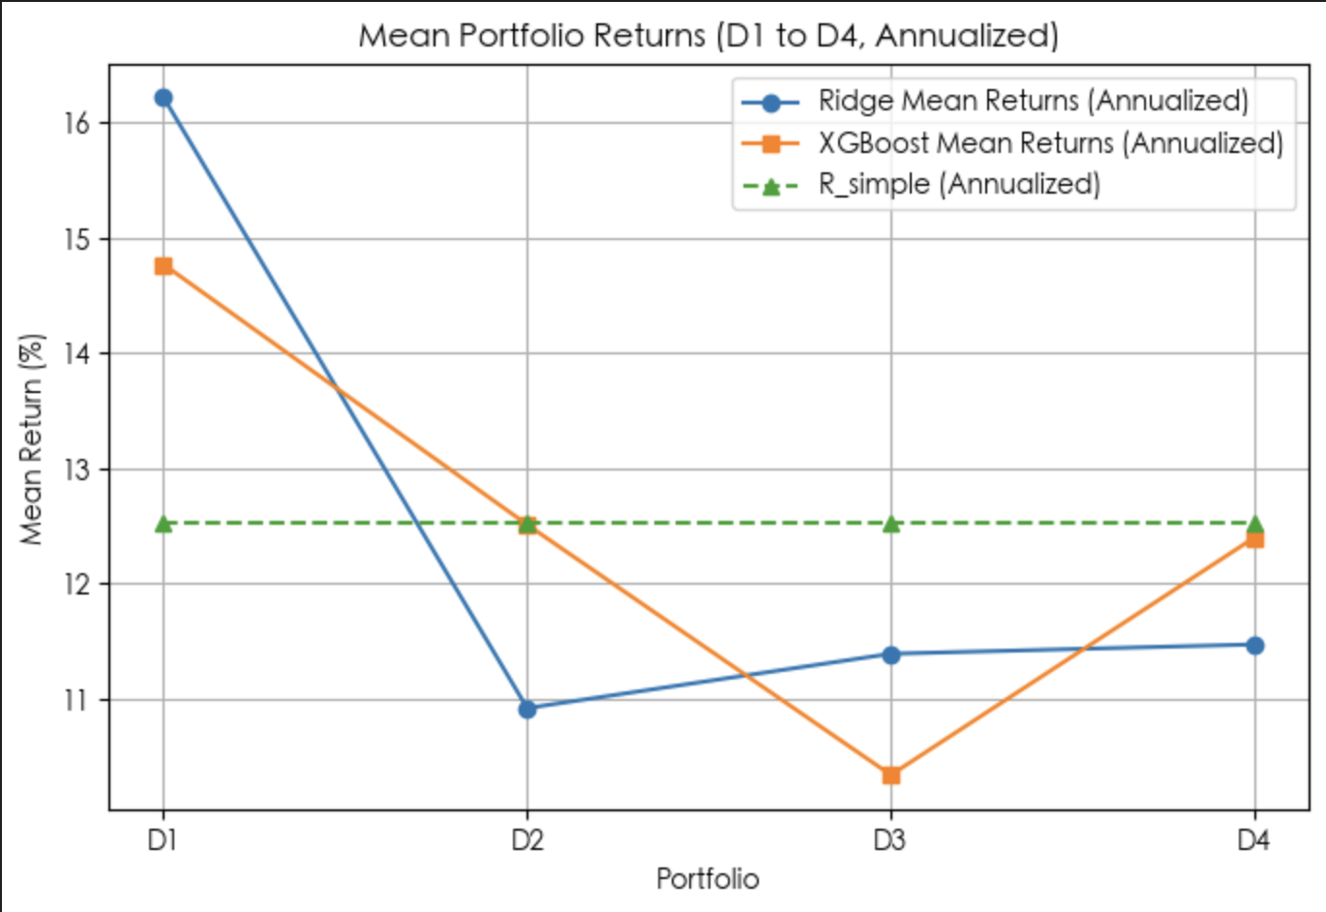
數值結果
Do the portfolio returns exhibit monotonic decreasing performance?

Slide 6

數值結果
RLS Statistics Comparison :
Does the $Ｒ_{t+1}^{LS}$of non-linear model have greater mean and mean-to-vol ratio than those of linear model?
I think the answer is No.
 | Ridge | XGBoost
Mean | 4.748285 | 2.369910
Volatility | 52.919604 | 45.964640
Mean-to-Volatility Ratio | 0.089726 | 0.051559

Slide 7
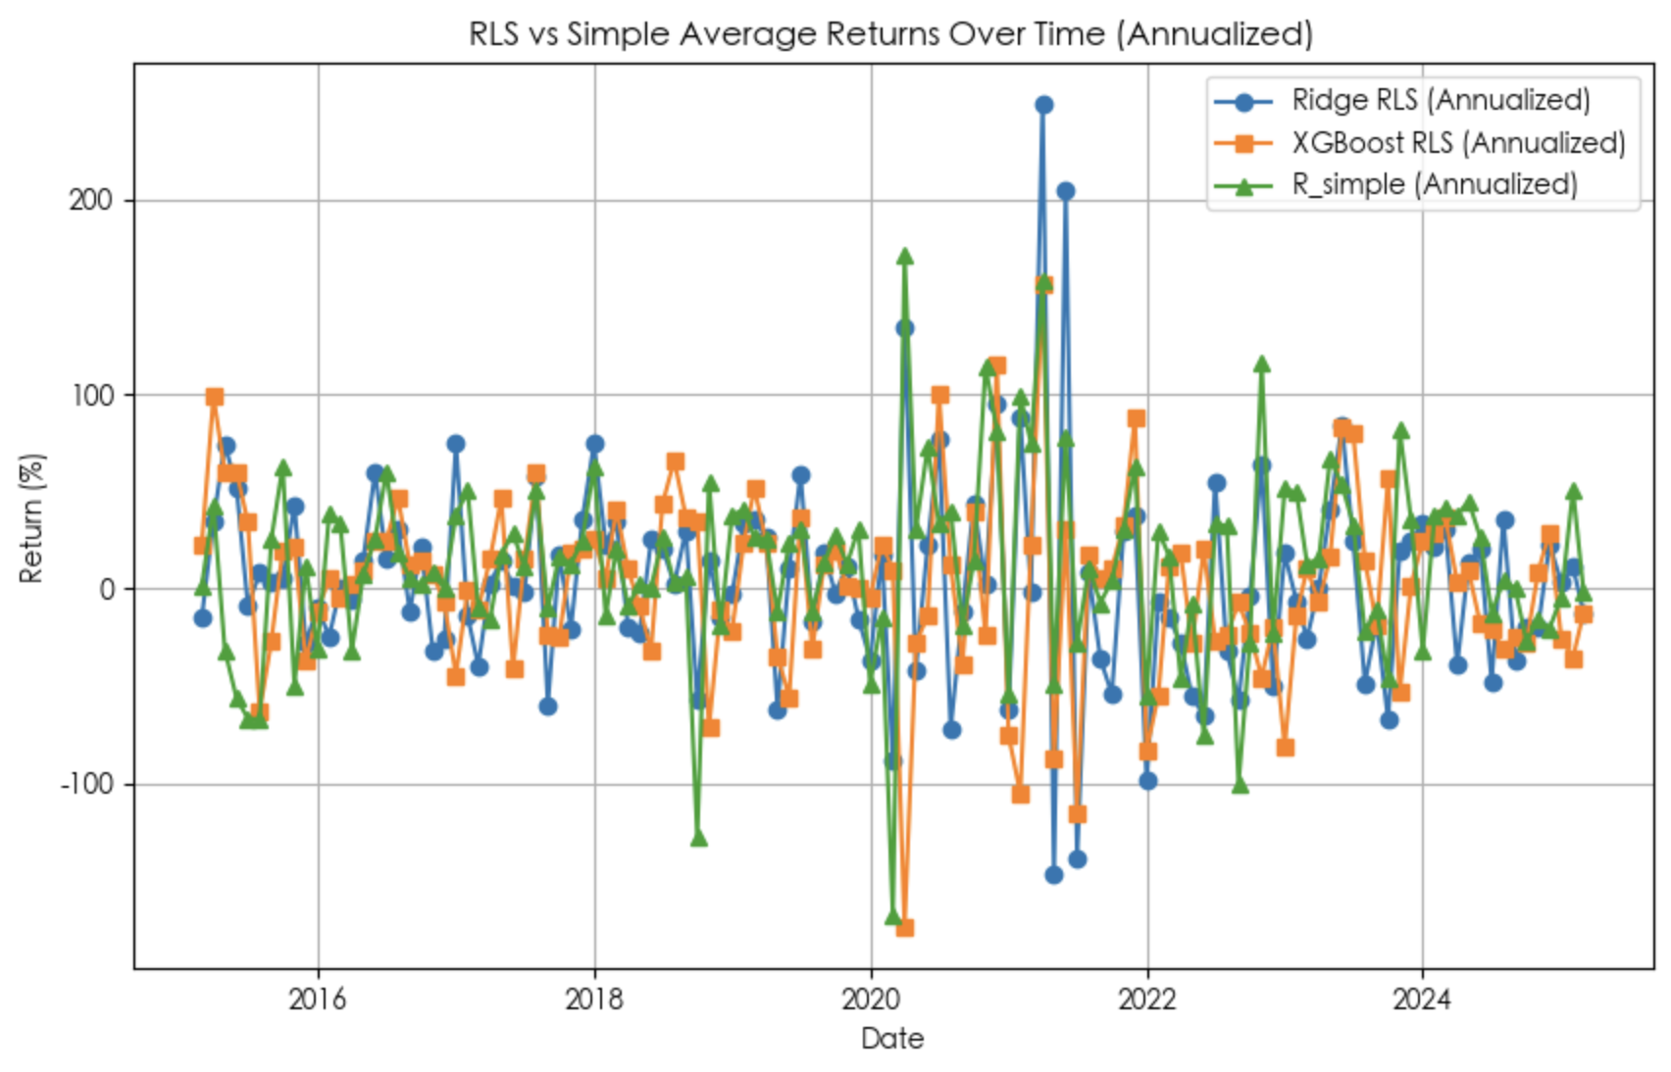

數值結果
Do the long-short portfolio $R_{t+1}^{LS}$of both models beat the simple average portfolio returns $R_{t+1}^{simple}$?

Slide 8
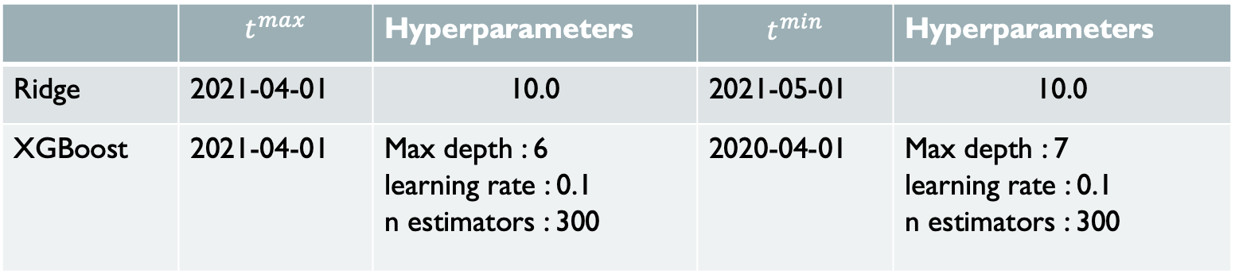
數值結果
 | $$t^{max}$$ | Hyperparameters | $$t^{min}$$ | Hyperparameters
Ridge | 2021-04-01 | 10.0 | 2021-05-01 | 10.0
XGBoost | 2021-04-01 | Max depth : 6 learning rate : 0.1 n estimators : 300 | 2020-04-01 | Max depth : 7 learning rate : 0.1 n estimators : 300

Slide 9
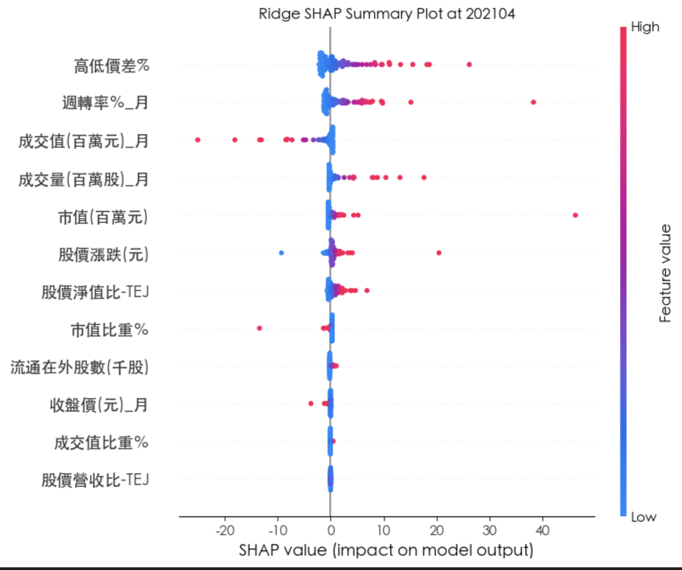
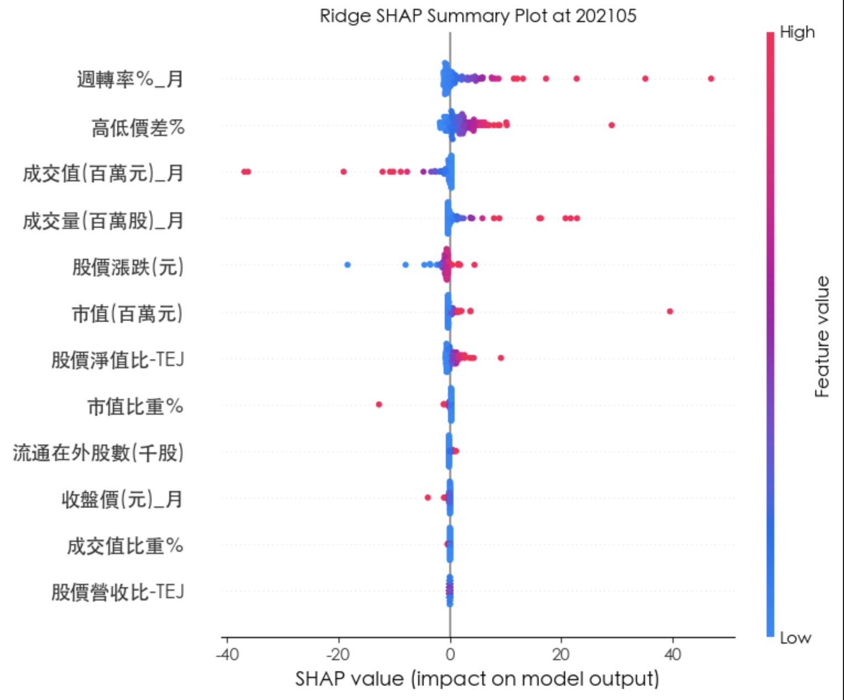
數值結果
SHAP for Ridge

Slide 10
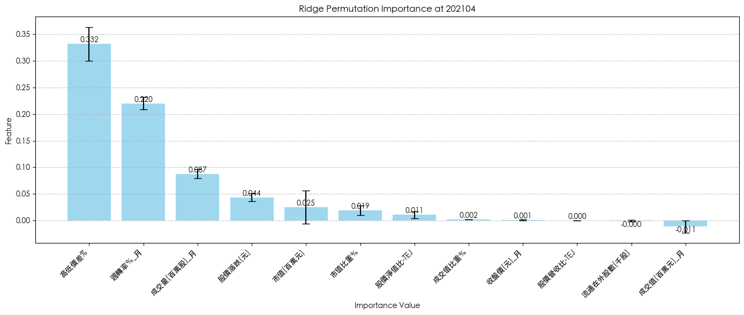
數值結果
permutation-based for Ridge

Slide 11
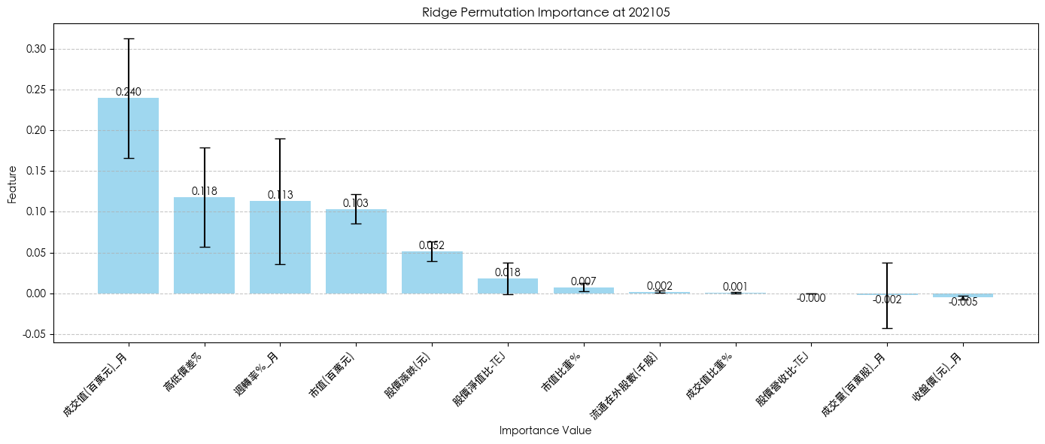
數值結果
permutation-based for Ridge

Slide 12
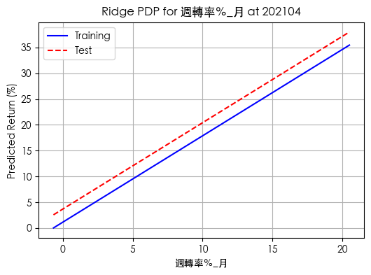
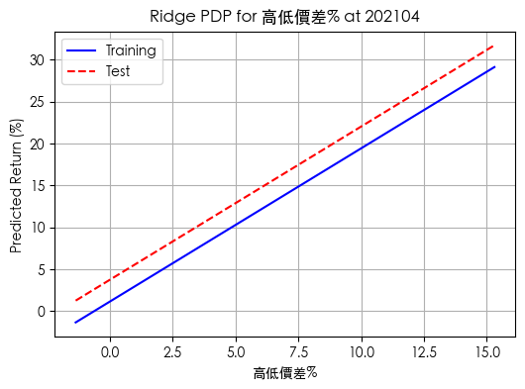
數值結果
For the most important predictors, show the PDP

Slide 13


數值結果
For the most important predictors, show the PDP

Slide 14
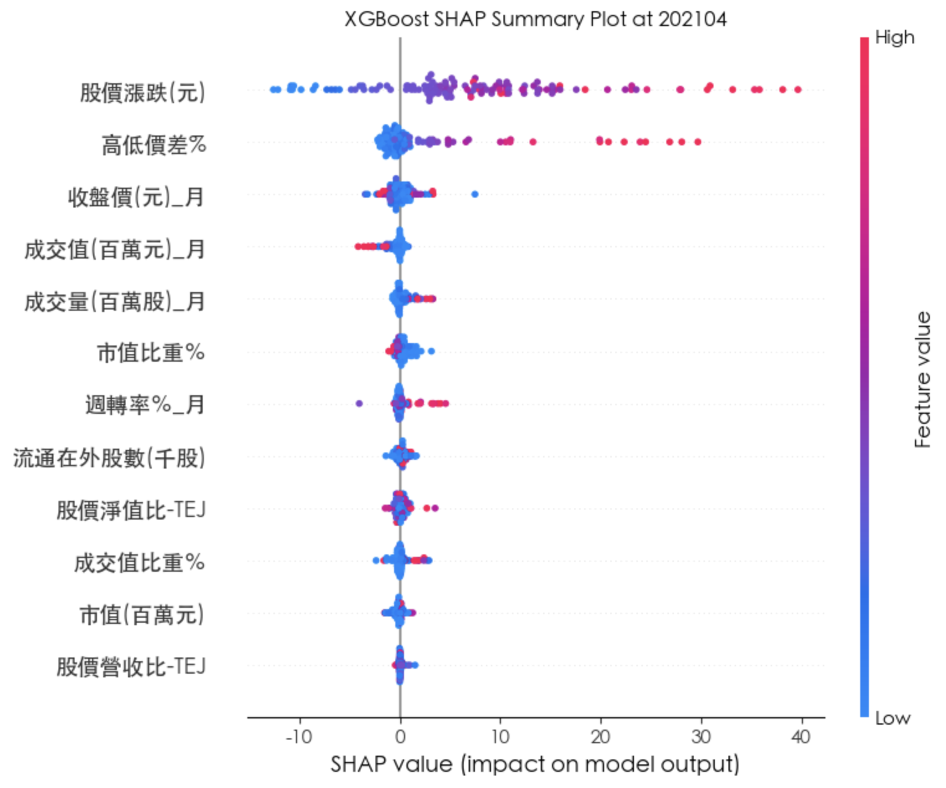
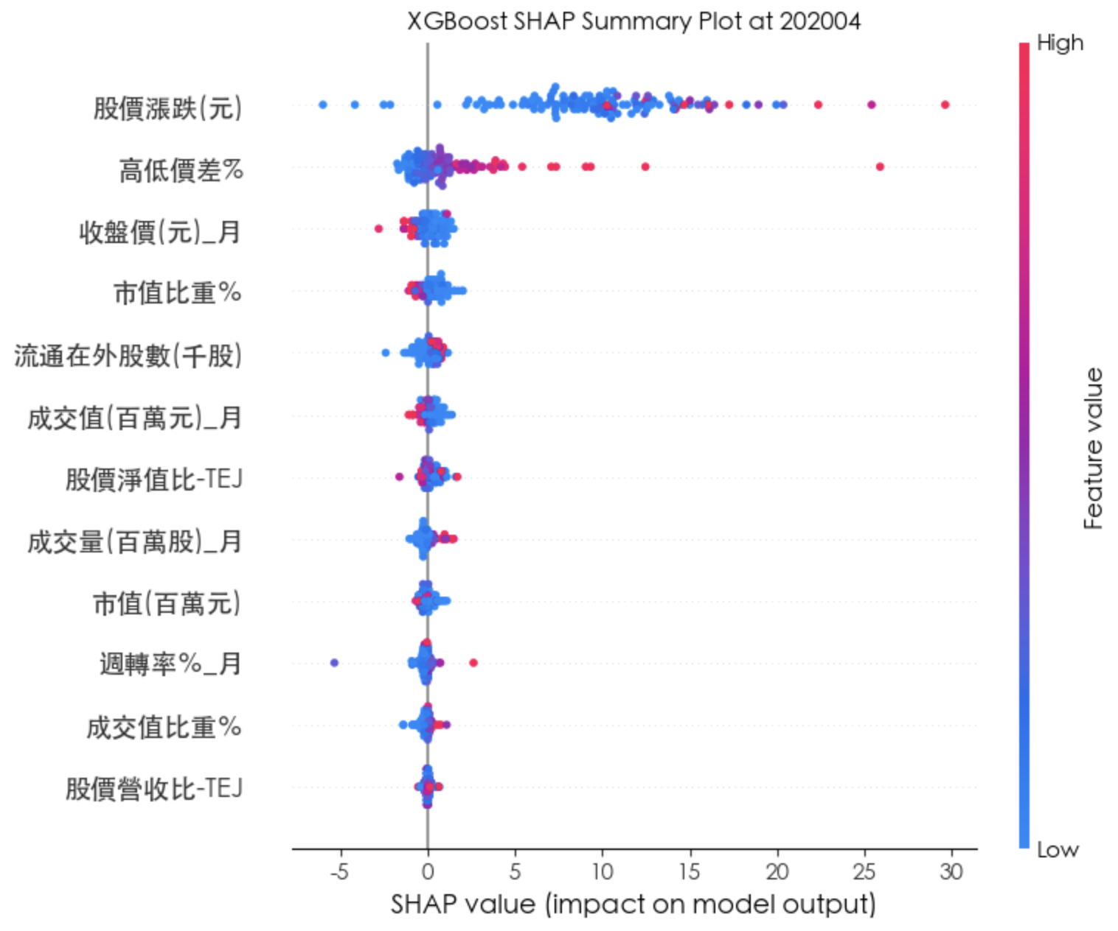
數值結果
SHAP for XGBoost

Slide 15
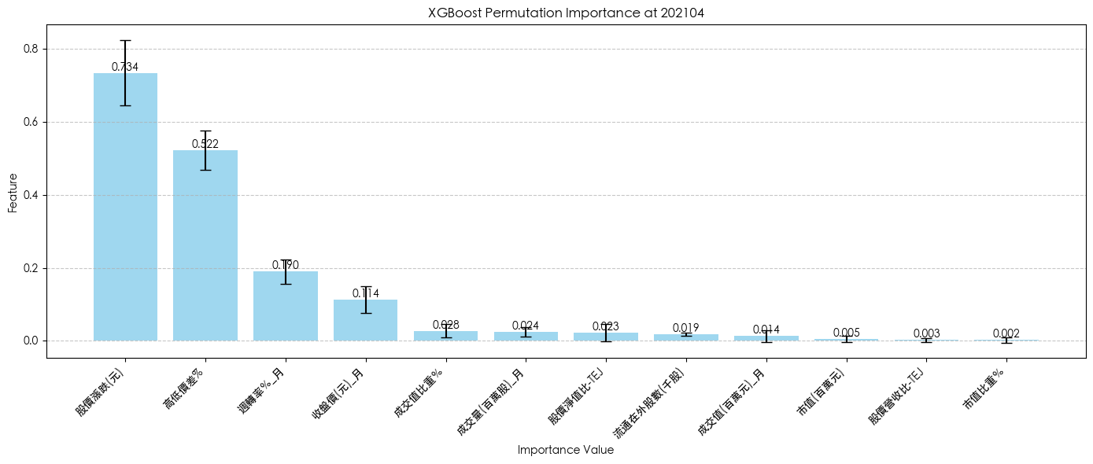
數值結果
permutation-based for XGBoost

Slide 16
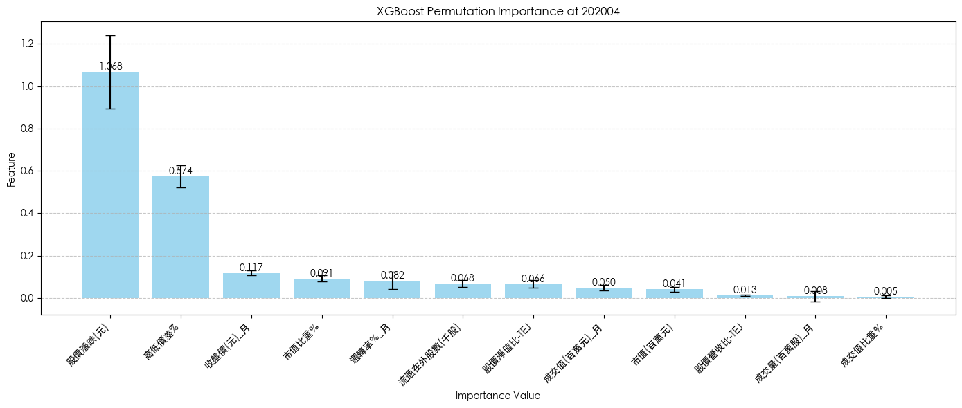
數值結果
permutation-based for XGBoost

Slide 17
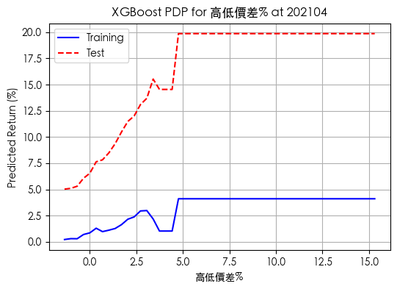
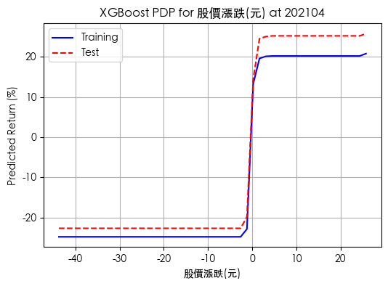
數值結果
For the most important predictors, show the PDP

Slide 18
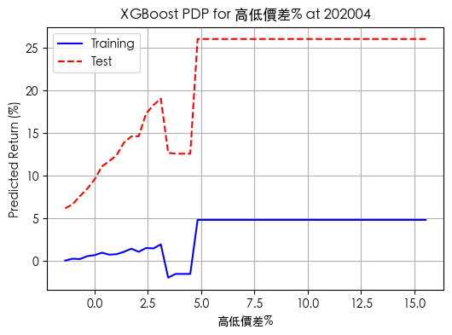
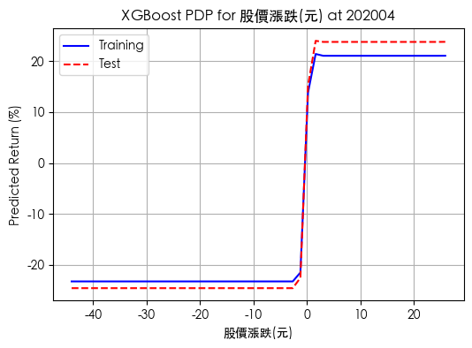
數值結果
For the most important predictors, show the PDP

